Slide 1
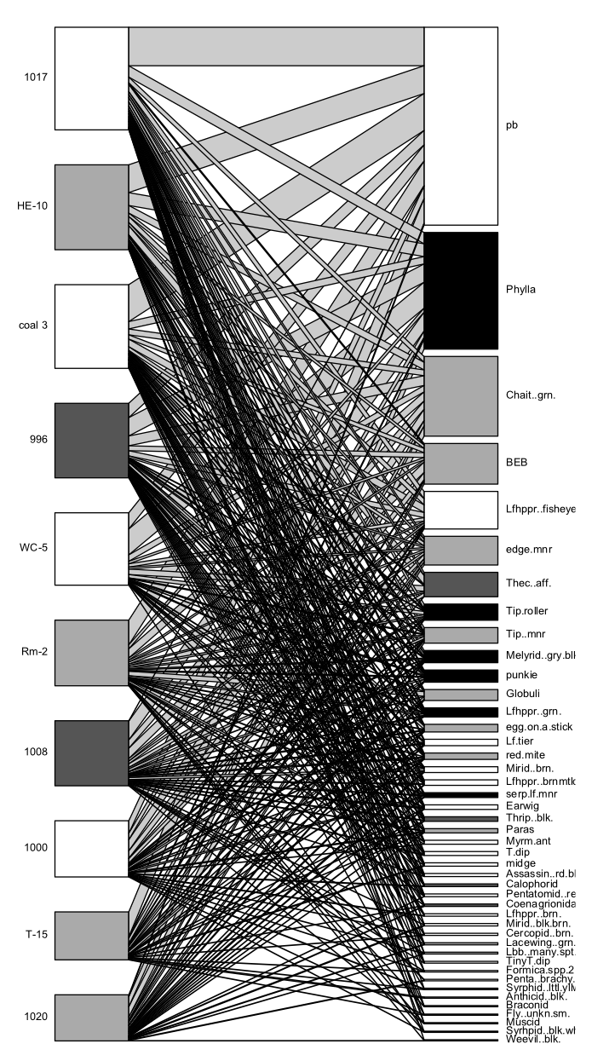
1) Plant-Herbivore interaction networks have been observed to be "modular" (i.e., form groups of multiple plant and multiple herbivore species that interact more with each other than other species), 2) This modular structure is supposed to minimize the negative impacts of herbivory and is therefore evolutionarily favored, and 3) We would predict the same pattern to occur at the scale of plant genotype, where groups of genotypes should interact with groups of herbivores.
Preliminary Results:
- If we use your composition data (removing any species that occurs less the 3 times) to model a network of genotypes and arthropod species, we can examine the modular structure of these networks and see how Pemphigus influences the structure of these networks,
- This is highly preliminary, but we find significant modularity (see attached image) in the 2008 control trees but not the exclusion trees when we look at arthropods of mixed trophic levels
- I need to run these analysis again with just herbivores in it, but the preliminary results are interesting.
Figure: bipartite network of cottonwood genotype (left) and arthropod species (right) that shows significant modularity (z = 3.82, p = 0.038), indicated by color. Genotypes and species are in order of increasing marginal totals (bottom to top).

